Slide 1
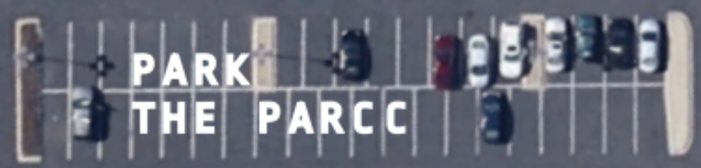


Why and How Webinar
Thursday, October 23

Slide 2
Welcome
Raise Your Hand and More Than A Score
Basic info on participating in the webinar
How and when to ask questions

Slide 3
Outline
Why is Illinois getting a new test?
What is PARCC?
Why shouldn't Illinois give PARCC this year?
What should Illinois do instead?
How we can Park the PARCC?

Slide 4

Why is Illinois getting a new test?
Title 1 funding requirements
Illinois state law: public schools must test every student in reading and math once a year in 3-8th and once in high school
IL used the ISAT for elementary and
PSAE (ACT) for high school

Slide 5


Why is Illinois getting a new test?
Notes:
As part of the 2009 stimulus package, the federal Department of Education came up with another way to effect education policy change.
Instead of tying guaranteed funding to fulfilling requirements, they created a competition among states for additional funding: Race To the Top (RTTT)
In order to participate in RTTT, states had to fulfill a long laundry list of education reforms, like evaluating teachers based on test scores and remove caps on the number of charter schools. Among these was the requirement to adopt new standards---the Common Core---and new tests aligned with them.

Slide 6
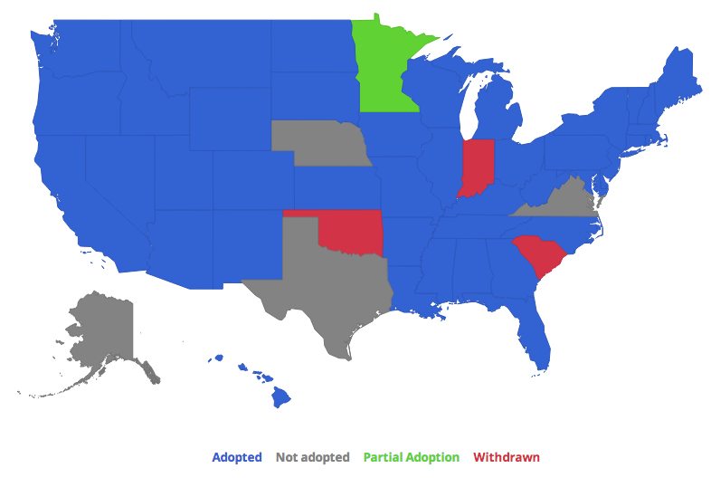
Why is Illinois getting a new test?
Notes:
46 states + DC adopted the CCSS. 3 have since withdrawn.

Slide 7


Why is Illinois getting a new test?
Notes:
Most states also joined one of two Common Core test consortia, Partnership for Assessment of Readiness for College and Careers (PARCC) or Smarter Balanced Assessment Consortium (SBAC).
Illinois joined the PARCC.

Slide 8


Why is Illinois getting a new test?
$42.8 million in funding…
…only 1.5% of $2.7 billion in state education funding in the last five years in Illinois
Notes:
Illinois submitted multiple applications to RTTT...and finally won the fabulous sum of $42.8 million
…to put it in perspective that’s just 1.5% of the $2.7 billion budget cuts in state education funding in the last five years in Illinois.

Slide 9
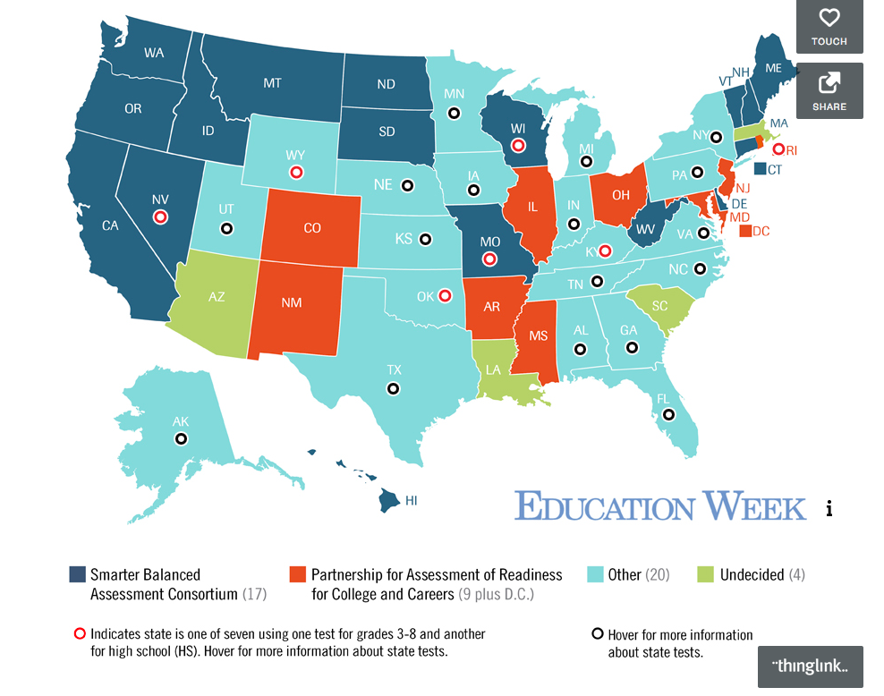
Why is Illinois getting a new test?
Notes:
Now it’s 2014 ---
3 states have dropped out of CCSS. And of 23 original PARCC members, only 8 states + DC will be giving PARCC to all their elem and HS students this spring (RI and MA will give it to some)
Why is everyone fleeing?

Slide 10
Why is Illinois getting a new test?
<Question Intermission>
Notes:
Now it’s 2014 ---
3 states have dropped out of CCSS. And of 23 original PARCC members, only 8 states + DC will be giving PARCC to all their elem and HS students this spring (RI and MA will give it to some)
Why is everyone fleeing?

Slide 11

What is PARCC?
Longer
More difficult
More expensive
But, still just another standardized test from Pearson

Slide 12
What is PARCC?
Computer-based exam
About 10 hours for elementary students, 11 for high school students
Hours split over testing in March and May
Two 20-day windows for administering

Slide 13
What is PARCC?
Pearson Marketing
Interactive!
Drop-down menus
On-screen highlighting
Videos
Drag and drop text chunks into answer boxes
Reality
Tiny scroll boxes for long reading passages
“Enhanced” multiple choice is still...multiple choice
Computer scoring

Slide 14
What is PARCC?
Test questions are intended to be more “rigorous”
Cut scores will likely be set so more children will fail than on previous state tests
Notes:
Similar to what was done for 2013 and 2014

Slide 15
What is PARCC?
PARCC expected to use data from the NAEP to determine cutoff scores
  typically about ⅓ of students are judged proficient
Common Core-aligned tests created by Pearson for NY set cutoffs so ~2/3 fail
Notes:
Esp among african-american students and english language learners

Slide 16
What is PARCC?
Illinois’ contract with Pearson is up to $160M over 4 years, depletes Race to the Top funds
One of the largest standardized testing contracts in history
Up to 10 million students, $24/student on the computer, $34 on paper
Added cost of technology resources

Slide 17
What is PARCC?
Pearson – long history of test issues
MN, 2000 – misgraded 45k+ graduation tests, lawsuit with $11M settlement
IL, 2011 – 144 students in five Chicago schools receive zeroes due to scoring error. The state sought nearly $1.7 million from Pearson, which could not explain how the errors occurred.
OK, 2012 – After major test delivery delays, state replaces Pearson as its testing contractor
NY, 2012 – More than 7K NYC elementary and middle school students wrongly blocked from graduation by inaccurate “preliminary scores” on Pearson tests
Source: FairTest

Slide 18
What is PARCC?
<Question Intermission>

Slide 19
Why shouldn't IL give PARCC this year?
Common Core standards not yet fully implemented in many schools
Incomplete and inadequate accommodations for English Language Learner (ELL) and (IEP) students. Math questions in Spanish will not have been field tested.
Questionable quality and reliability
Many schools ill-equipped with computers or Internet bandwidth needed to administer test
Most kids are already being tested more than once a year in reading and math using nationally-normed tests

Slide 20
Why shouldn't IL give PARCC this year?
PARCC is not used for college admissions or scholarships
PARCC pushes ACT earlier, potentially resulting in lower scores – jeopardizing scholarships and admissions
Tests only a subset of accelerated students, which questions its use as a growth measure
AP test dates fall within same window as planned PARCC administration

Slide 21
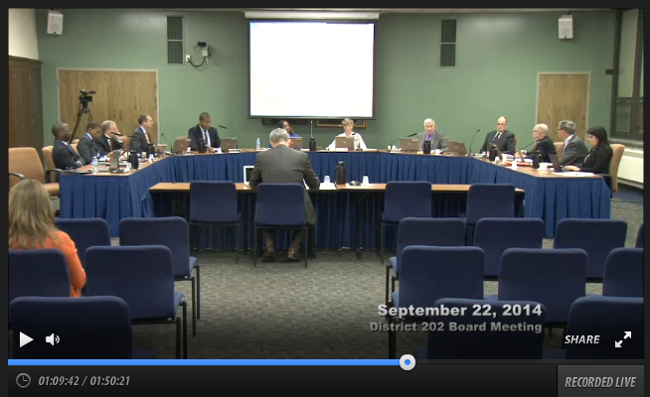
Why shouldn't IL give PARCC this year?
Evanston Township High School board meeting: good overview of problems at HS level
(Start at minute 47)

Slide 22
Why shouldn't IL give PARCC this year?
Vague and confusing questions -- needs further revision before widespread use
You can try out PARCC questions here: http://practice.parcc.testnav.com

Slide 23
Why shouldn’t IL give PARCC this year?
<Question Intermission>

Slide 24
What should Illinois do?
Ask for a waiver to not give PARCC this year
  IL gets money from the federal government to help low-income students (Title I funds)
  In order to get Title I funds, states must do certain things, like annual testing
  But USED can grant states waivers and with political pressure than can choose to provide funds even if states don’t fulfill every requirement

Slide 25
What should Illinois do?
Illinois State Board of Education needs to tell the US Department of Education that Illinois will:
Delay the PARCC until the test is improved and validated through additional field testing
Continue the use of other nationally-normed reading/math tests in 2014-15, such as MAP/ACT, that Illinois schools are already using anyway
Move ACT High School testing back to its original date in April (currently early March)

Slide 26
What can we do to make IL Park the PARCC?
We need to pressure our elected officials at the local, state and federal levels to get ISBE to ask for a waiver and the USED to grant it.

Slide 27
What can we do to make IL Park the PARCC?
Here’s some ideas we’ve had so far.
Sign RYH’s petition at petitions.moveon.org/sign/isbe-acquire-a-waiver-1
Call or meet with your federal and state legislators to let them know your concerns
Share this information and our position paper with other parents
Hold a Park the PARCC party at your school so parents can try the test themselves
Attend a Raise Your Hand/More Than a Score Information Session
Share your concerns at ISBE (11/21), school board, PTA, LSC meetings: put PARCC on its agenda to make sure everyone understands its implications
Attend the RYH forum on high quality assessment on 11/18 in Pilsen
Do you have other suggestions for getting more parents involved?

Slide 28
What can we do to make IL Park the PARCC?
<Questions, suggestions, discussion…>
info@ILRaiseYourHand.org

